Slide 1
Big Data Introduction
By Shalini Gupta

Slide 2
Agenda
World of data
What is Big Data?
Visualize the size of Data
5 V’s of Data
Real World use cases

Slide 3
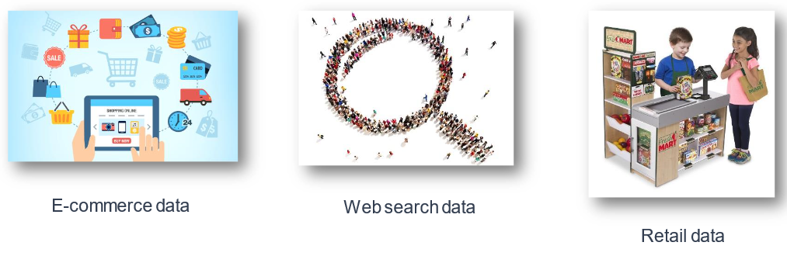
World of Data

Slide 4
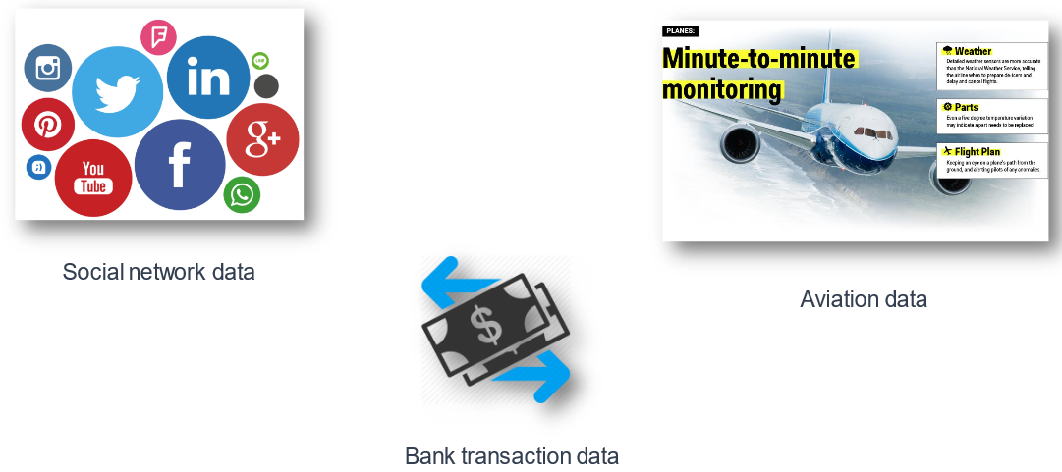
World of Data

Slide 5
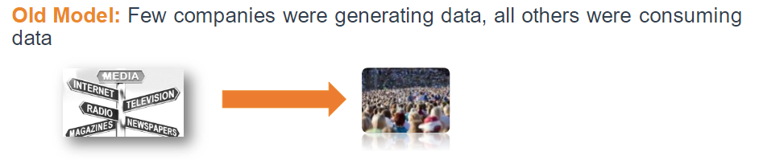
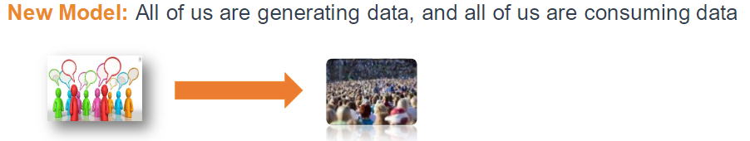
Model of data Generation and Consumption Changing

Slide 6
What is Big Data?
Big data is a term for data sets that are so large or complex that traditional data processing applications are inadequate. Challenges include data analysis, capture, search, sharing, storage, transfer, visualization, querying and information privacy.

Slide 7
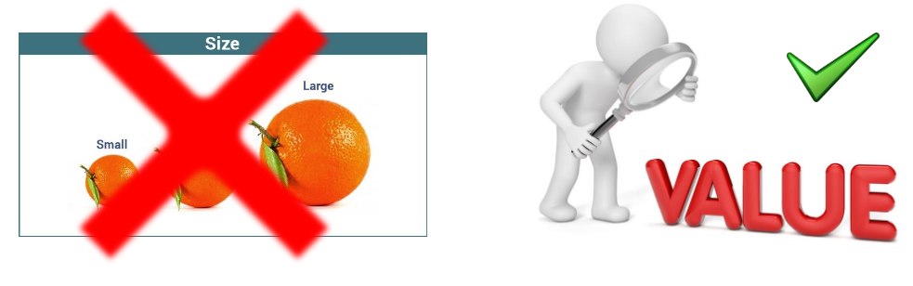
Big Data is not only about size but also about value

Slide 8
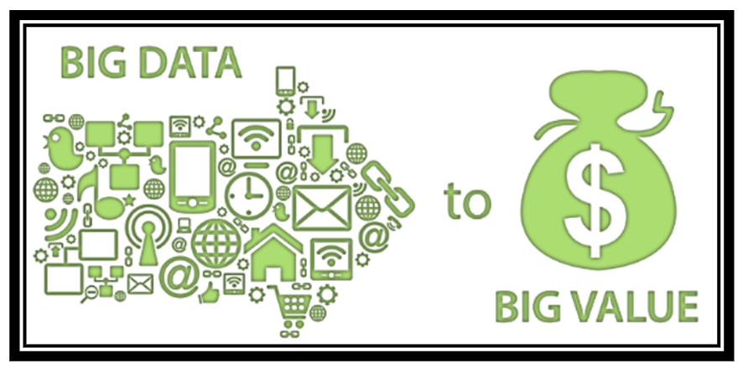
How to bring value from Big Data?

Slide 9
….How big is BIG?

Slide 10
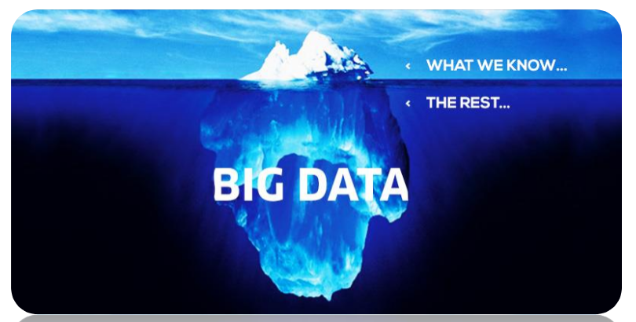

Slide 11
Look at Big Data in a different way!!

Slide 12
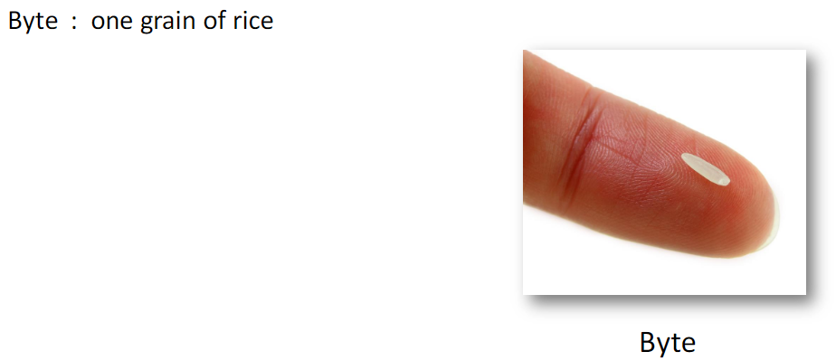

Slide 13
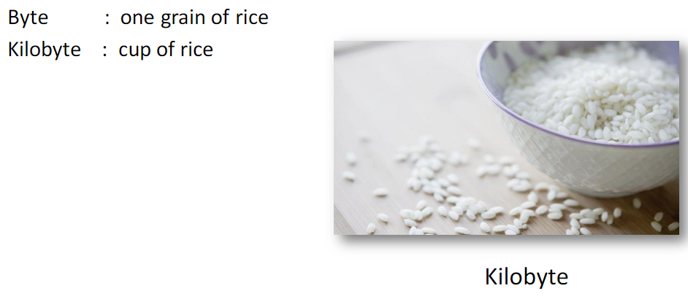

Slide 14
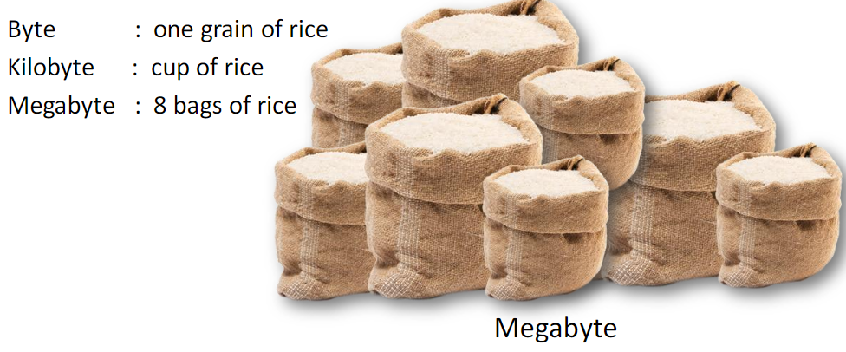

Slide 15
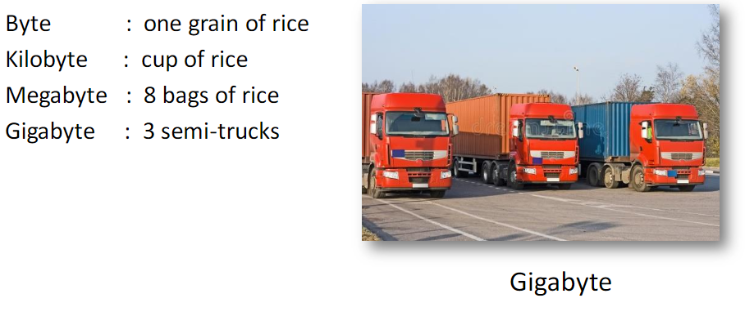

Slide 16
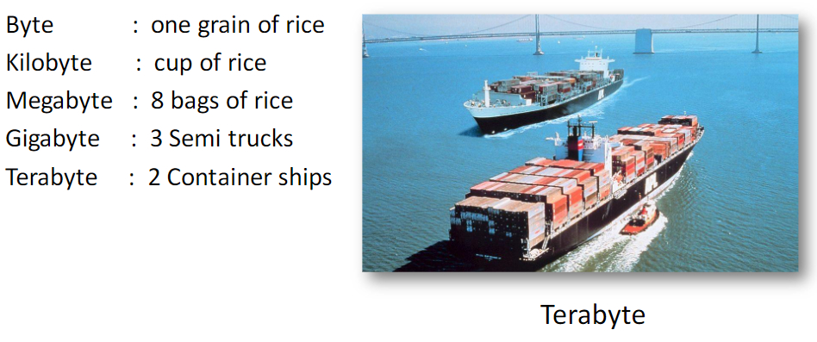

Slide 17
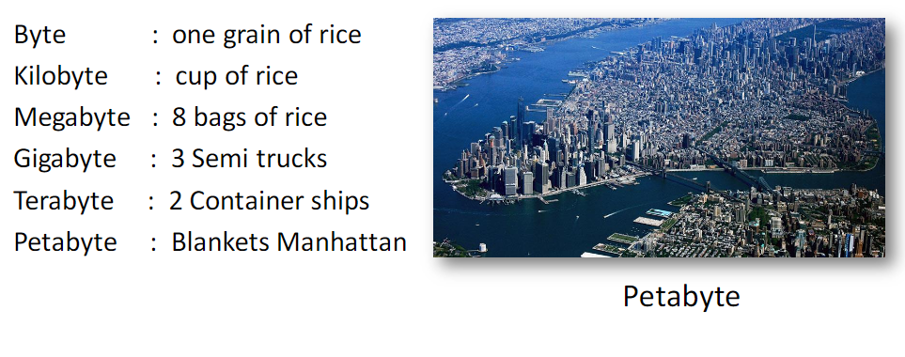

Slide 18
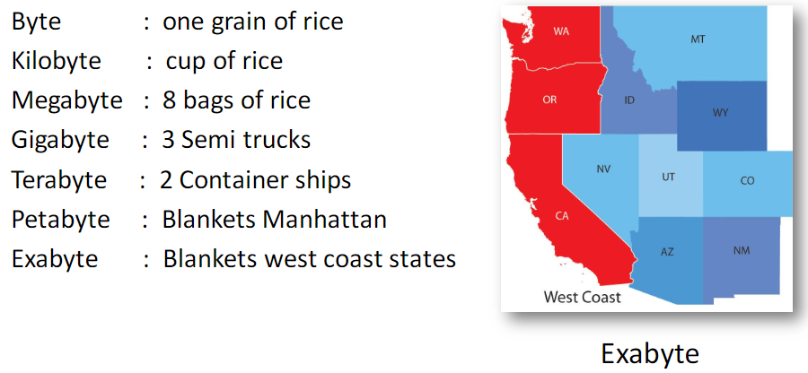

Slide 19
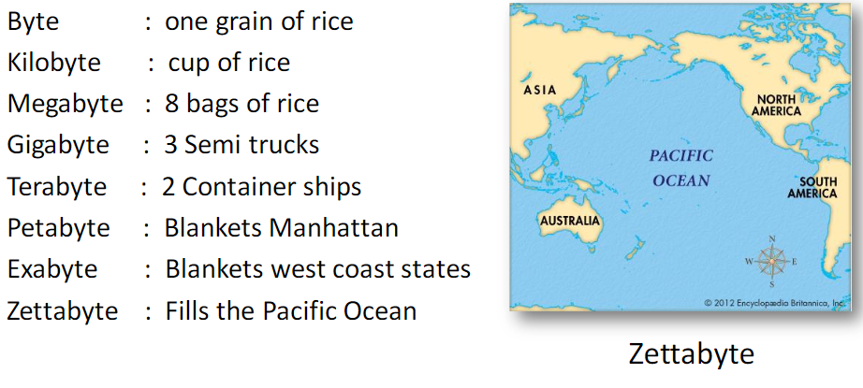

Slide 20
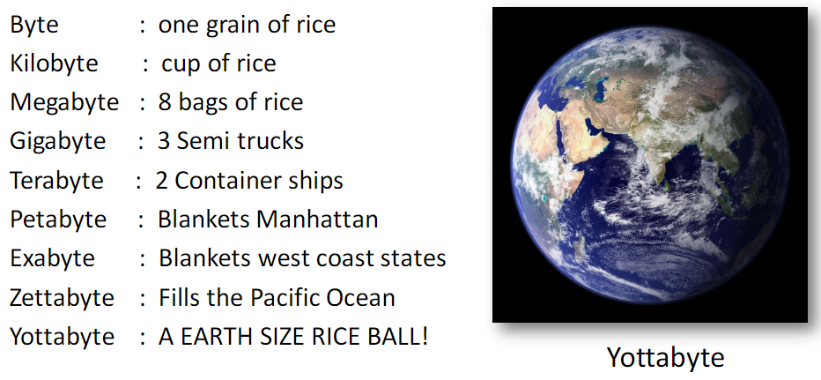

Slide 21
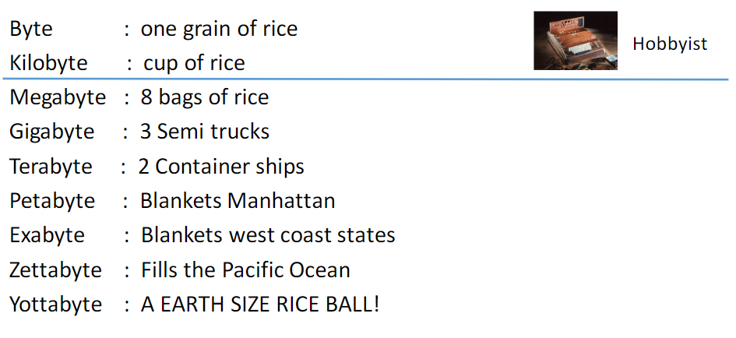

Slide 22
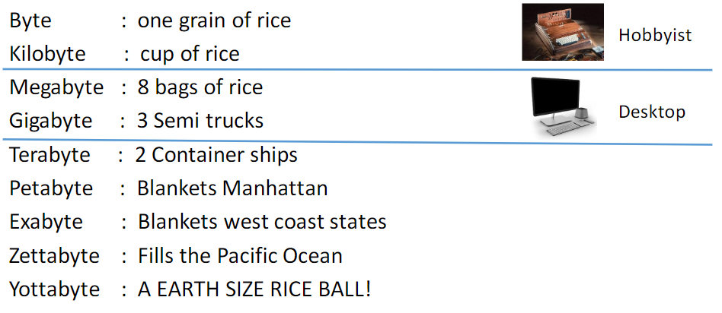

Slide 23
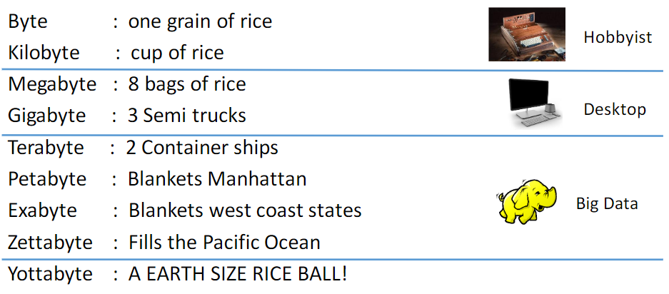

Slide 24
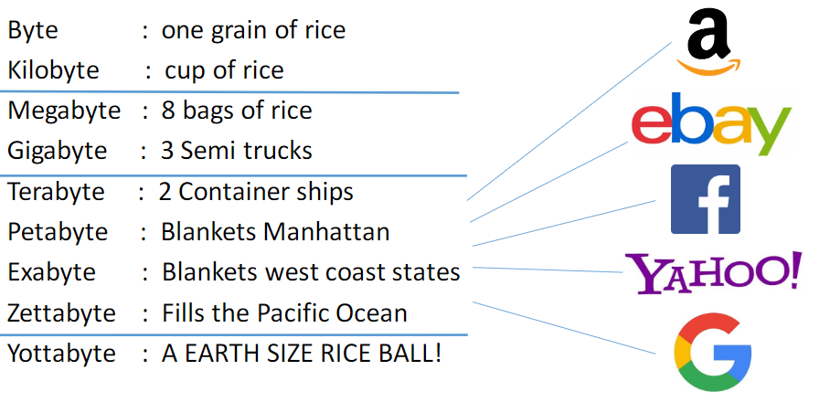

Slide 25
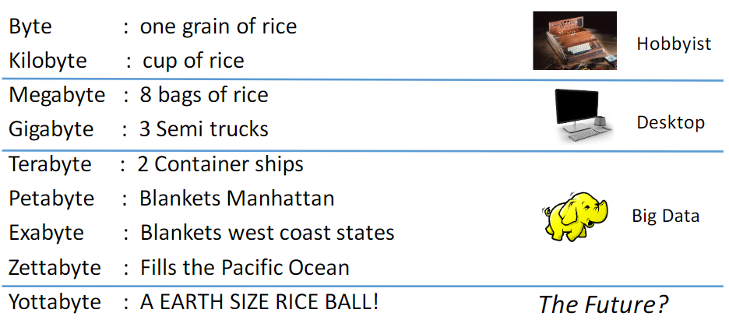

Slide 26
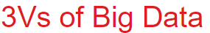
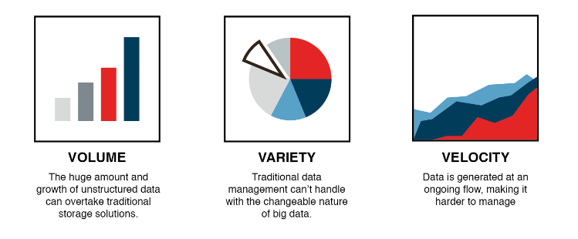
Characteristics of Big Data

Slide 27
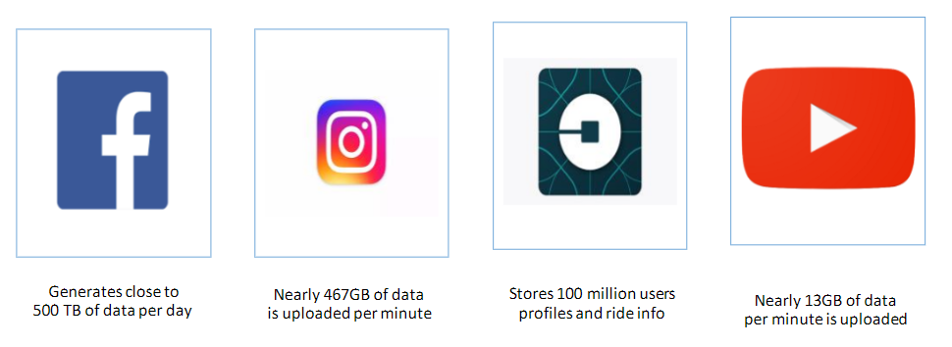
Volume

Slide 28
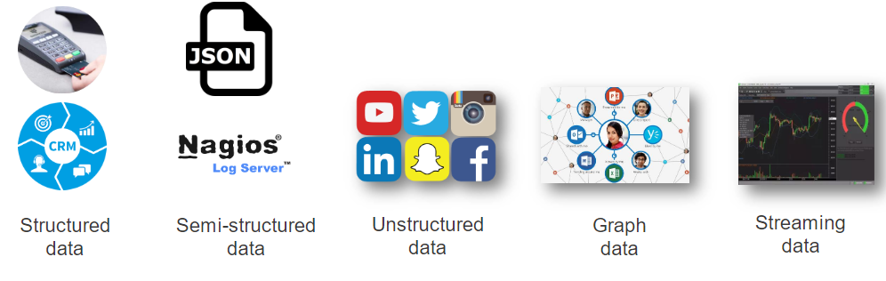
Variety

Slide 29

Velocity

Slide 30
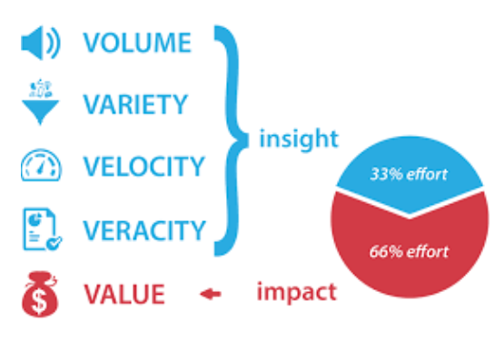
5Vs of Data

Slide 31




Gaining insight
Cost Effectiveness
Benefits of Big Data
Marketing Effectiveness
Prediction and Decision Making

Slide 32
Real World Use Cases……

Slide 33


Slide 34
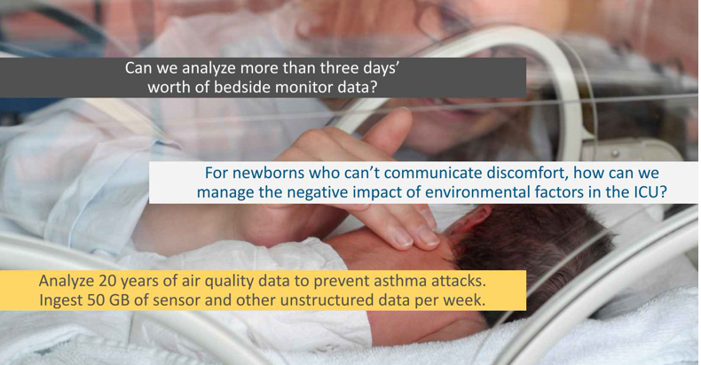

Slide 35


Slide 36
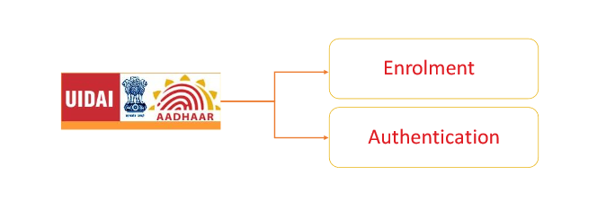
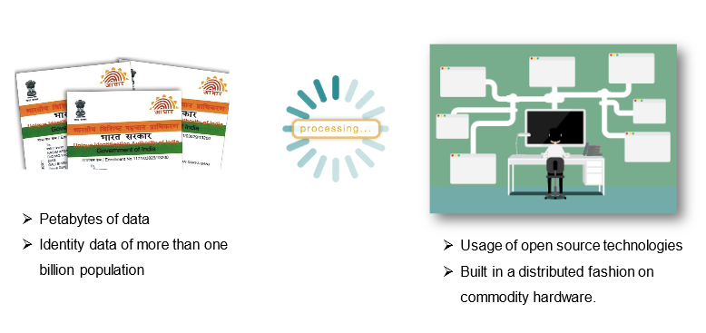

Slide 37
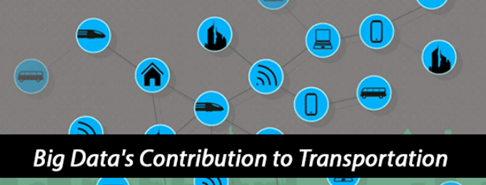

Slide 38


Slide 39
Reference Links
https://searchdatamanagement.techtarget.com/definition/big-data
https://www.infoq.com/presentations/big-data-use-cases
https://www.digitaldoughnut.com/articles/2018/january/big-data-analytics-real-world-use-cases
https://intellipaat.com/blog/7-big-data-examples-application-of-big-data-in-real-life/

Slide 40
Thank you!

